Slide 1

Energy Consumption Forecasting using Predictive Modeling for Smart Grids
Presented by-
Group: 5
Aeshwa Kachhadiya
Bimala Joshi
Cezane Karki
Moulya Reddygari Bhupal
Amey Tillu

Slide 2







CONTENTS
Data Collection & Preparation
Exploratory Data Analysis
Feature Engineering
Addressing Data Issues
Modeling Techniques
& Evaluation
Appendix
Business Insights & Recommendations

Slide 3
Data Merging and Preparation
Data Source: 20-year Data of Energy Station
Data Merging - Consolidation & Cleaning (Functions: merge_paths, data_merger, data_refiner)
Source Data: Hourly data from distributed subdirectories.
Merge Strategy: Concatenated files per metric group, then performed an Outer Join on the common 'Date' index to combine all time series.
Initial Cleanup: Dropped sparse, redundant, or ambiguous columns (e.g., 'Unnamed', 'Cooling load (GJ)').
Standardization: All remaining columns were renamed for clarity (e.g., PV_Generation_kW, Outdoor_Air_Temp_C).
Imputation & Target Definition:
Missing Data Handling: Used a K-Nearest Neighbors (KNN) Imputer (5 neighbors) to estimate and fill missing values in numerical features.
Target Variable: Defined the final prediction target:
TARGET_Total_Electric_Load_kW = Load_A + Load_B
Outlier Management: Capped extreme values in the target variable using a robust IQR-based method (99th percentile (+-) 3 * IQR).
Feature Engineering (Time & Weather):
Time Encoding: Applied Sine/Cosine transformations to 'Hour', 'Day of Week', and 'Wind Direction' to capture cyclicality.
Thermal Stress: Calculated Heating Degree Days (HDD) and Cooling Degree Days (CDD) using a 18 Degree celsius base temperature.
Lag & Trend: Created a 24-hour lagged load feature and an Exponentially Weighted Moving Average (EWMA) for recent trend capture.
Context: Identified and included a binary 'Is_Holiday' feature.

Slide 4
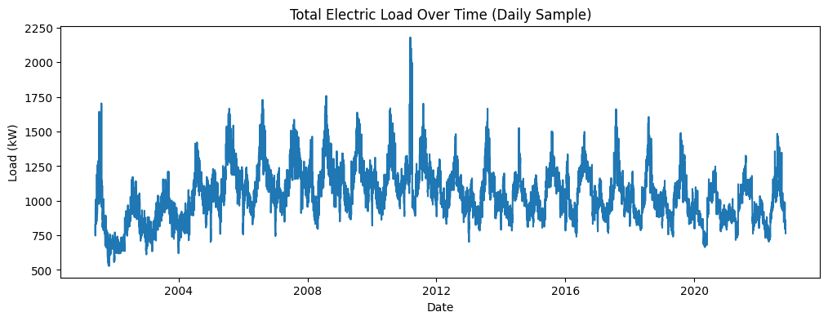
Exploratory Data analysis
Data set was having 187728 rows and 34 features
No null values were present in the data
Continuous and discrete data
Data types ->
Data Type | Count
datetime64 | 1
float64 | 32
int64 | 2
Total Electric Load Over Time:
Demand rising and falling consistently across years
Noticeable peaks likely caused by extreme weather or operational spikes
Overall trend remains relatively stable
Energy system has strong nonlinear behavior

Slide 5
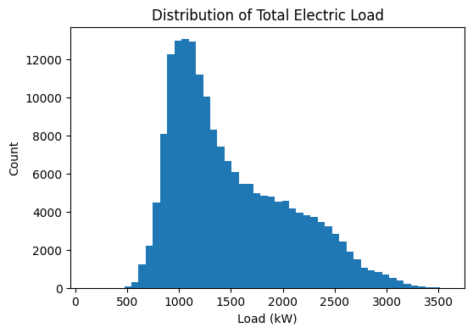
Distribution of Electric Load
Distribution of total electric load is right-skewed.
Most energy consumption values fall between 900–1500 kW.
Frequency sharply drops as load increases.
Daily operations fluctuate within a stable mid-range.
Extreme peaks occur occasionally due to seasonal changes, weather effects, or sudden demand spikes.

Slide 6
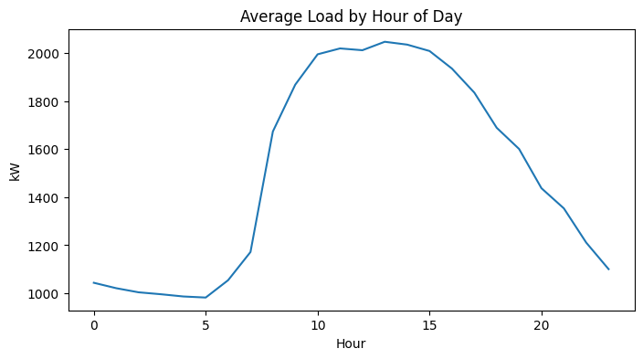
Per Day Energy Consumption Pattern
Strong daily consumption pattern.
Stays low during early morning hours (1–6 AM).
Rapidly increases after 7 AM.
Peaking between 11 AM and 3 PM.
After the afternoon peak, the load gradually decreases through the evening.

Slide 7
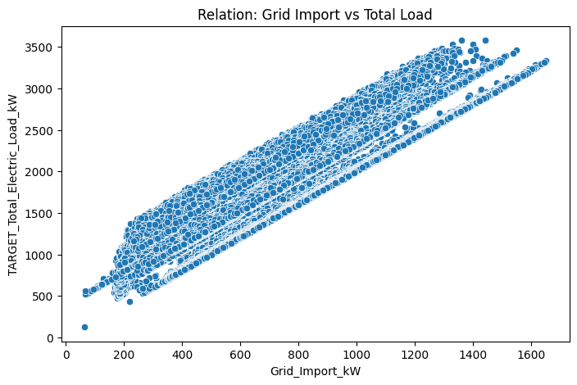
Relationship of Grid Import and Total Load
Strong positive linear relationship.
Total demand increases, the grid consistently supplies more.
Tight clustering and parallel bands indicate operational patterns.

Slide 8

Feature Engineering
Time-based features
Extracted hour, day, month, and weekday to capture daily, weekly, and seasonal consumption patterns.
Cyclical encodings
Converted hour-of-day and day-of-week into sine/cosine pairs to represent natural periodicity in energy usage.
Temperature stress indicators (HDD/CDD)
Computed Heating Degree Days and Cooling Degree Days to reflect how extreme weather drives load changes.
Lag features (past-only)
Created lagged versions of the load (previous hour, previous 24 hours) to help the model learn temporal dependencies.

Slide 9
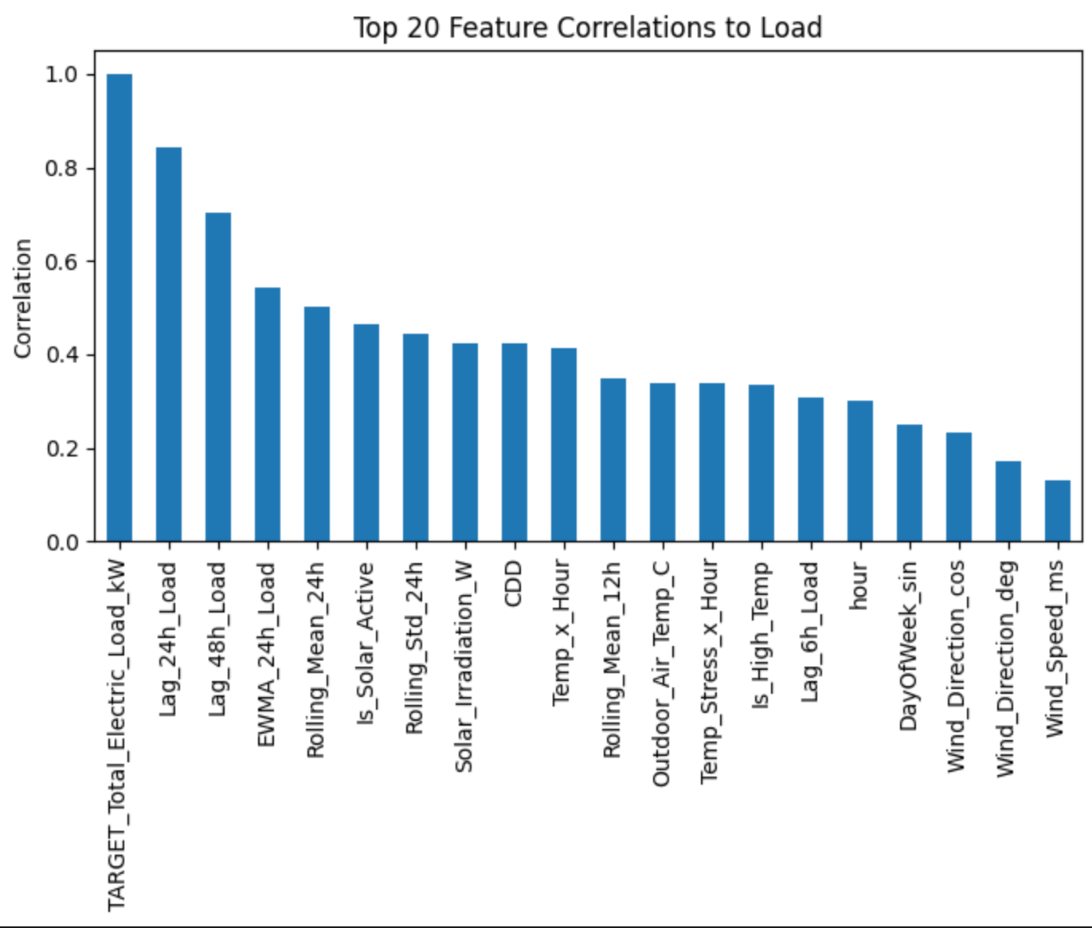
Feature Engineering
Rolling window features
We generated 24-hour and 48-hour rolling averages and rolling standard deviations to smooth noise and highlight consumption trends.
Rate-of-change features
We added first-difference and percentage-change features to quantify acceleration or deceleration in demand.

Slide 10

Addressed Data Leakage Issue
We removed columns that-
Represent components or sub-measures of the target load at the same timestamp.
Contain generation, fuel usage, or operational outputs that are known only after demand is realized.
Provide insight into future system behavior that would not be available in real-time forecasting.

Slide 11
Modeling Techniques
To ensure a comprehensive and reliable forecasting pipeline, we intentionally selected a diverse set of models. Each model was chosen for a specific statistical and functional reason.
1. Linear Regression – Baseline Model
Linear Regression was chosen to establish a fundamental baseline.It helps determine whether the underlying relationships in the data are roughly linear and provides a reference point to evaluate the improvements offered by advanced models.
2. XGBoost – Nonlinear Learner
XGBoost was chosen because it is known to perform well on structured data with noise, seasonality, and nonlinear interactions which is exactly the characteristics of energy load consumption.It also handles outliers and sudden demand spikes effectively.
3. HistGradientBoosting – Fast, Efficient Boosting for Large Data
HistGradientBoosting was selected because it is optimized for very large datasets like ours (187K rows).It captures nonlinear patterns and complex feature interactions efficiently using histogram binning.
4. LightGBM – High Speed and High Dimensionality
LightGBM was selected for its ability to train extremely fast while maintaining excellent accuracy. Given our engineered features (lags, rolling stats, cyclical encodings), LightGBM is ideal for handling many features and capturing subtle temporal patterns.

Slide 12
Modeling Techniques
6. Ridge Regression – Regularization for High-Dimensional Data
Ridge Regression was included to test whether applying L2 regularization would reduce overfitting in a dataset containing many correlated features (time lags, rolling windows, cyclical encodings). It helps evaluate stabilization of coefficients in complex temporal datasets.
5. Random Forest
Random Forest was included to evaluate bagging-based ensemble learning. It reduces variance effectively and performs well without extensive hyperparameter tuning, making it a good benchmark for nonlinear performance.
7. AdaBoost – Focus on Hard-to-Predict Samples
AdaBoost was selected because it adaptively focuses on errors in previous iterations.
This helps test whether boosting weak learners improves predictions for volatile periods in the load data.
7. ANN (Deep Learning) – Capturing Complex Temporal Nonlinearity
Artificial Neural Networks were included because energy consumption data often shows nonlinear temporal behavior. ANNs can model such patterns and interactions that may not be captured fully by tree-based models.
7. AdaBoost – Focus on Hard-to-Predict Samples
AdaBoost was selected because it adaptively focuses on errors in previous iterations.
This helps test whether boosting weak learners improves predictions for volatile periods in the load data.
8. AdaBoost
AdaBoost was selected because it adaptively focuses on errors in previous iterations. This helps test whether boosting weak learners improves predictions for volatile periods in the load data.
We intentionally evaluated algorithms that are well-suited for detecting nonlinear patterns, seasonal fluctuations, and temporal dependencies inherent in energy-consumption data. By comparing linear models, regularized models, boosting algorithms, ensemble tree methods, and deep learning architectures, we ensured a fair and comprehensive performance assessment. This structured approach allowed us to understand the strengths and limitations of each model and ultimately select the most suitable one.

Slide 13
Model Performance
 | Model | MAE (kW) | RMSE (kW) | R²
1 | LightGBM | 66.03 | 94.33 | 0.9691
2 | XGBoost | 66.42 | 95.45 | 0.9683
3 | HistGradientBoosting | 69.58 | 100.91 | 0.9646
4 | Random Forest | 72.43 | 106.68 | 0.9604
5 | ANN (Deep Learning) | 84.23 | 121.12 | 0.9490
6 | Ridge Regression | 144.25 | 187.07 | 0.8783
7 | Linear Regression | 144.26 | 187.07 | 0.8783
8 | AdaBoost | 160.20 | 203.70 | 0.8557
LightGBM delivered the best overall performance with the lowest MAE and RMSE and the highest R² score, indicating strong predictive accuracy and stability.
XGBoost and HistGradientBoosting also performed competitively, effectively capturing nonlinear patterns in the data.
Traditional linear models and AdaBoost showed significantly higher errors, confirming that tree-based ensemble methods are better suited for the complex, fluctuating nature of energy-consumption forecasting.

Slide 14
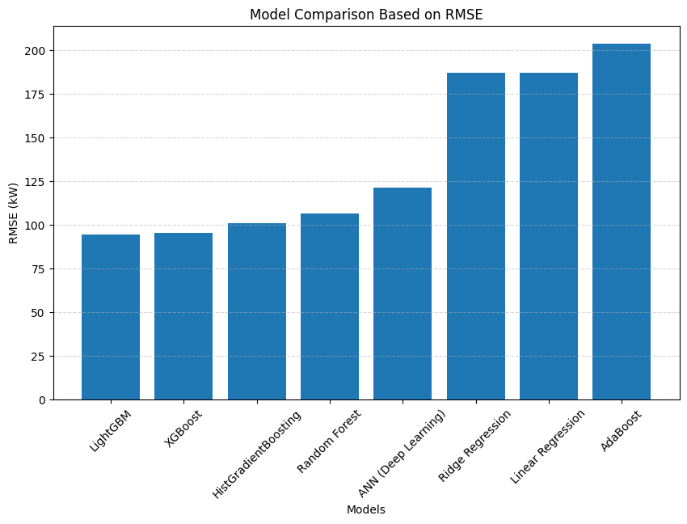
Model Performance

Slide 15
Evaluation Techniques
Mean Absolute Error (MAE)
  Measures Average of Error
  How much model is off
  Lower the MAE, better the model
Root Mean Squared Error (RMSE)
  Measures Prediction error
  Penalize values heavily
  More sensitive
  Lower the RMSE, better the model
R^2
  Variation in target variable
  Value range from 0 to 1
  Higher the R^2 value, better the model
In our forecasting problem, lower MAE is more important because it directly tells us how far our predictions are from the actual energy load in real units (kW). Unlike classification accuracy, which is not applicable here, MAE provides a clear and interpretable measure of prediction error. A lower MAE therefore indicates a more reliable and operationally useful model for energy-demand planning.

Slide 16
Analysis of the Models & Final Model Selection
LightGBM and XGBoost are the top-performing models, achieving the lowest RMSE values (95–97 kW). This indicates that both models are highly effective at capturing nonlinear patterns and fluctuations in the energy load data.
HistGradientBoosting also performs strongly, with RMSE just above 100 kW. It demonstrates that tree-based boosting models consistently outperform simpler algorithms.
Random Forest and ANN fall in the mid-range (110–115 kW). While they show decent predictive ability, they are slightly less accurate compared to boosting models.
Ridge Regression and Linear Regression show significantly higher RMSE values (185–190 kW). This confirms that linear models are not sufficient for this dataset, which contains clear nonlinear and seasonal patterns.
AdaBoost has the highest RMSE (205 kW), indicating relatively poor performance on this dataset. This suggests that AdaBoost struggles with the complexity and variability of hourly load data.
LightGBM
MAE: 66.03
RMSE: 94.33
R^2: 0.9691
It has consistent lowest errors and highest R^2
Excellent Prediction, Accuracy and Strong generalization
Final Model ->

Slide 17
Insights and Recommendations
Insights into Energy Usage Patterns and Potential Demand Spikes
  The energy usage data analysis has shown very strong and easily predictable daily and weekly seasonality,
  Demand has been increasing steadily during the operating hours that are generally considered standard starting with a steep morning rise-up to the peak period of the day, which is between 4 PM and 8 PM;
  Load is very much dependent on the previous day's consumption confirming a cyclic pattern that enables the operational team to utilize the demand forecasts that are based on the pattern adequately.
  This pattern is heavily influenced by the weather, as high outdoor air temperatures lead to high cooling loads which are mainly responsible for the afternoon heat-driven peaks, these peaks combined with operational events such as the morning start-up surges and the post-lunch ramps define the main scenarios leading to the critical demand spikes.

Slide 18
Insights and Recommendations
Strategies to Optimize Energy Distribution and Reduce Peak Load
The facility should adopt data-guided strategies to begin with Load Shifting which entails moving the flexible consumption (pre-cooling or non-essential equipment use)
Flattening and reshaping the load curve in order to achieve distribution optimization and peak load reduction.
Recommendations:
Predictive HVAC Optimization should be part of this strategy, and it will make use of the high accuracy of the forecasts to predict hot days
Finally, the use of Energy Storage Systems can add a new layer of optimization to distribution by the practice of charging the batteries during the off-peak hours (midnight to 5 AM) and then discharging the stored energy during the expected peak times, thus making the facility less reliant on costly external grid imports.

Slide 19
Evaluation of the Potential Impact of the Recommendations on Energy Efficiency
The application of these tactics will lead to considerable and quantifiable enhancement in energy efficiency and performance through a load curve that is, in effect, much flatter.
This would automatically result in considerable savings being realized through lesser exposure to high peak-pricing tariffs, which is the direct effect of the load curve being flattened.
Besides, the predictive management method will increase the operational ability by lessening the chances of equipment overload and unplanned shortages.
It will also be a great assistance to the environment by reducing the need for high-emission generation sources in the fast times of peak demand.
Ultimately, the frequency of sharp load fluctuations will reduce, leading to the extension of asset longevity. Thus, these data-driven recommendations will be the base for sustainable and cost-effective energy planning.

Slide 20

Appendix
GitHub Repository Link-
https://github.com/cezanekarki/Energy-Consumption-Analysis.git
The model is deployed on Streamlit - https://energyconsumptiontimeseriesforecasting-hnshvkhbjnhr8zssvhwqvb.streamlit.app/

